Slide 1

個人簡歷與作品
面試者
Chen, Sih-Yun
陳思云
Department of Electronic and Computer Engineering National Taiwan University of Science and Technology

Slide 2
Outline
個人簡介
論文研究
教育性晶片下線經驗
T18-109B The Implementation of a Symmetric Encryption Algorithm Based on DES (2020.04)
U18-109C Automatic String Matching Engine (2020 CIC contest) (2020.08)
專案與專題成果
Based On SoC Image Encryption and Decryption System Hardware and Software Co-design (2020.06)
A 16-bit RISC Computer Implementation (2019.12)
其他相關證書

Slide 3


個人簡介
基本資料
姓名 | 陳思云
信箱 | catloveu07@gmail.com
目前科系 | 國立台灣科技大學 電子工程所 計算機組
在校成績 | 碩士 | 平均GPA: 4.2
 | 學士 | 平均: 85 排名: 4
專業領域
指導教授 | 林銘波 教授
研究領域 | 數位IC電路設計
研究方向 | Data security and Cryptography
專長 | Verilog、C、(OS)Linux、Virtuoso
Tools | Xilinx ISE (Isim)、NC Verilog、Design Compiler、IC Compiler
 | 、Xilinx Vivado、Verdi
碩士相關課程 | FPGA系統設計實務(A+)/高等計算機組結構(A)/軟硬體共同設計(A-)/
 | VLSI(A+)/超大型積體電路測試與可測試性設計(A+)

Slide 4
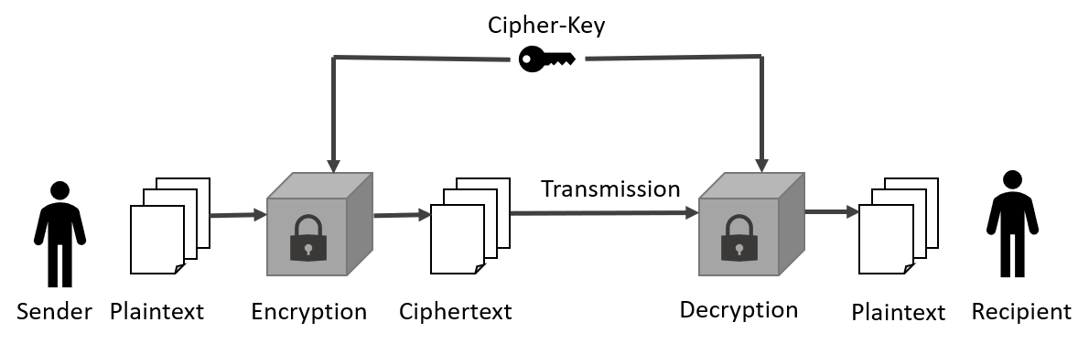
論文研究
M
: Message
Message confidentiality and data integrity.
F
: Generating function of
message-authentication code
f(M)
: Message-authentication code
E
: Encryption
D
: Decryption
Fig.1 General symmetric message encryption and decryption flow
K₁
M
M
F
M
||
E
D
F
compare
f(M)
f(M)
K₂
E(K,M||C(M))
K₂
K₁
Fig.2 Message authentication and confidentiality architecture

Slide 5
Counter with Cipher Block Chaining-Message Authentication (CCM)
CCM architecture can be divided into two parts:
Encryption with CTR mode: Enhance the security of the data.
Authentication with CBC mode: Ensure the integrity of the message.
N
: Nonce
A
: Associate data
B
: 128-bit block
N
A
Plaintext
Plaintext
Ctr₀
Formatting Function
CTR
AES
Ctr₁
Ctr₂
Ctr₃
Ctr_{r+1}
CBC-MAC
MSB(Tlen)
B₀
B₁
B₂
……
B_{r}
Key
AES
AES
AES
……
AES
……
P₀
P₁
P₂
P_{r}
Tag
Key
AES
AES
AES
AES
C₀
C₁
C₂
……
C_{r}
C
Tag
||
Fig.3 The architecture of CCM message authentication part
Ciphertext
AES
:Advance Encryption Standard Algorithm
Fig.4 The architecture of CCM message encryption part
Notes:
CCM用於無限區域網路，例如 WiFi 藍芽
這套CCM加密標準由美國NIST公開發表
N { 7, 8, 9, 10, 11, 12, 13 }.
tag { 4, 6, 8, 10, 12, 14, 16 }.
A 2⁶⁴ and 0
P 2⁶⁴ and 0

Slide 6
AES Algorithm
Plaintext(128 bits)
Secret key(128/192/256)
 |  |  |  |  |  | …….
 |  |  |  |  |  | …….
State array (4*4*8)
State array (size depends on AES type)
Initial transformation
Key
Expansion
State array (4*4*8)
1th Round key(4*4*8)
Round 1 to (N-1)
SubBytes
ShiftRows
MixColumns
AddRoundKey
Table.1 AES parameters (AES-128, AES-192 and AES-256)
i^{th} Round key(4*4*8)
Key size | 128 | 192 | 256
Plaintext block size | 128 | 128 | 128
Number of rounds | 10 | 12 | 14
Round key size | 128 | 128 | 128
Expanded key size | 44 | 52 | 60
Round N
SubBytes
ShiftRows
AddRoundKey
N^{th} Round key(4*4*8)
State array (4*4*8)
 |  |  |  |  |  | …….
Ciphertext(128 bits)
Fig.5 Advanced encryption standard(AES) algorithm architecture
Notes:
AES是2006年後取代DES很常見的加密技術，也是由美國NIST發表，用於ATM/ ethernet路由器 、電子金融業 …

Slide 7
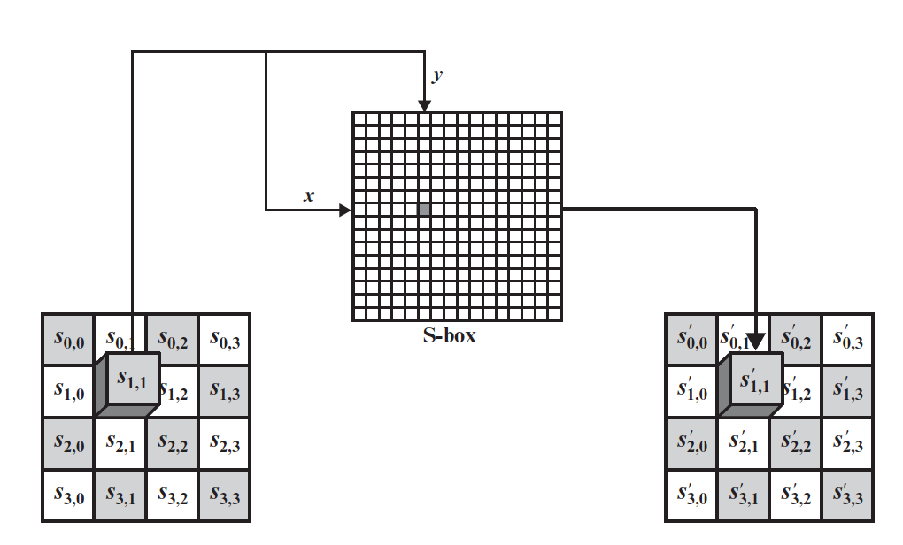
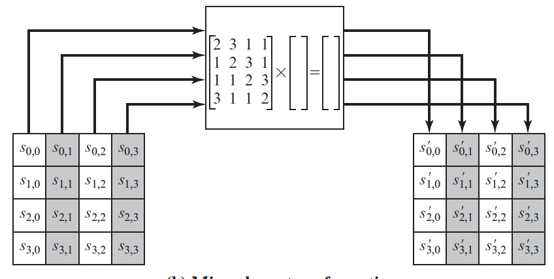
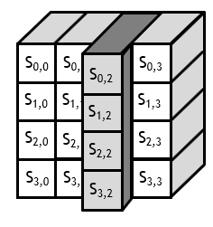
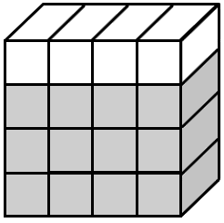
AES Algorithm: Encryption Process
Substitute bytes:
Shift rows:
Mix columns:
Add round keys:
S_{0,0}
S_{0,1}
S_{0,2}
S_{0,3}
S_{0,0}
S_{0,1}
S_{0,2}
S_{0,3}
… …
S_{1,0}
S_{1,1}
S_{1,2}
S_{1,3}
S_{1,1}
S_{1,2}
S_{1,3}
S_{1,0}
W₀
W₂
W₃
W₄
W₅
W₆
W₇
W₁
S_{2,0}
S_{2,1}
S_{2,2}
S_{2,3}
S_{2,2}
S_{2,3}
S_{2,0}
S_{2,1}
S_{3,0}
S_{3,1}
S_{3,2}
S_{3,3}
S_{3,1}
S_{3,2}
S_{3,3}
S_{3,0}

Slide 8
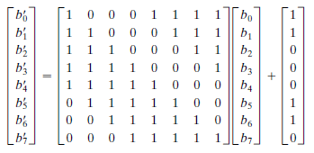
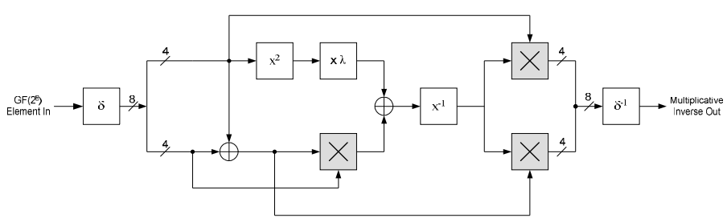
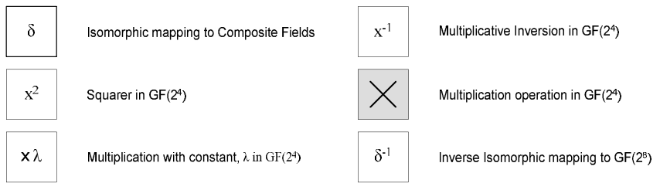
Area reduction – Replace the Sbox
Affine transformation:
Byte inversion: the multiplication operation in GF(2⁸)
formula (1)
Fig.6 One step in the AES encryption process called ”Substitute Bytes”
b
GF(2⁴)
GF(2⁴)
GF(2⁸)
c
GF(2⁸)
Fig.7 Byte inversion architecture
Fig.8 Arithmetic elements in a byte inversion

Slide 9
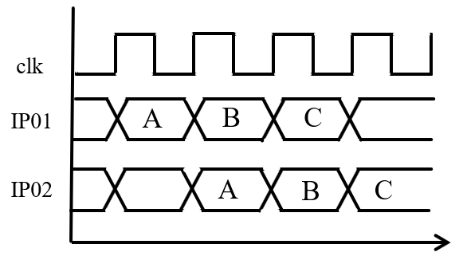
Pipelined S-box Computer
Area: 114 LUTs
Non-pipelined s-box computer lead to critical path. The max frequency of non-pipelined computer is 111 MHz.
Max frequency: 250 MHz
IP01
IP02
4
𝝌²
X 𝜆
en
en
8
𝜹
8
𝜹⁻¹
Byte_in
1
𝝌⁻¹
Affine transformation
8
1
Byte_out
4
0
0
0
0
Fig.9 Pipelined s-box computer architecture

Slide 10
sel
FSM
valid
aes_en
ready_out
sbox_data
Text encryption
S-box
RAM
Shift Rows
0
Row 1
Row 1
1
Mix Columns
Row 2
Row 2
x4
Add round keys
Sub
Bytes
2
3
1
1
Text
RAM
Initial add rk
0
1
Row 3
Row 3
1
Column 1
New Column 1
ciphertext
plaintext
Row 4
Row 4
data
0
Key
RAM
rk00
rk01
rk02
rk03
1
0
1
0
1
key buffer
S-box
RAM
AES hardware design (first version)
Use round key buffers. (on the fly) Use S-box to look-up data.
Sub
Bytes
Shift rows
Add round constants
Gfunction
Round key expansion

Slide 11
sel
FSM
valid
aes_en
ready_out
Text encryption
Shift Rows
Sub Bytes
Row 1
Row 1
x16
Sbox Computer
Mix Columns
Sbox Computer
Sbox Computer
Sbox Computer
Sbox Computer
Sbox Computer
Sbox Computer
Row 2
Row 2
Sbox Computer
Sbox Computer
Sbox Computer
Sbox Computer
Sbox Computer
x4
Add round keys
2
3
1
1
Text
RAM
Initial add rk
0
Row 3
Row 3
ciphertext
1
Column 1
New Column 1
plaintext
Row 4
Row 4
data
0
Key
RAM
rk00
rk01
rk02
rk03
1
0
1
0
1
AES hardware design (Second version)
Use affine transformation and multiplication inversion instead of s-box. Use non-pipelined s-box computer. Use round key buffers. (on the fly)
key buffer
x4
Sbox Computer
Add round constants
Sbox Computer
Sbox Computer
Sbox Computer
Shift rows
Gfunction
Round key expansion

Slide 12
sel
FSM
valid
aes_en
ready_out
Text encryption
Shift Rows
Row 1
Row 1
Sub Bytes
Mix Columns
x16
x16
Row 2
Row 2
x4
IP01
(pre-sbox computer)
IP01
(pre-sbox computer)
IP01
(pre-sbox computer)
IP01
(pre-sbox computer)
IP01
(pre-sbox computer)
IP01
(pre-sbox computer)
IP01
(pre-sbox computer)
IP01
(pre-sbox computer)
IP01
(pre-sbox computer)
IP01
(pre-sbox computer)
IP01
(sbox computer)
IP02
(sbox computer)
2
3
1
1
Text
RAM
Initial add rk
0
Row 3
Row 3
ciphertext
plaintext
1
Column 1
New Column 1
Row 4
Row 4
0
1
data
0
Key
RAM
rk00
rk01
rk02
rk03
1
0
Round
Keys
RAM
1
0
1
key buffer
AES hardware design (Third version)
Use affine transformation and multiplication inversion instead of s-box. Use pipelined s-box computer. Use round key memory.
x4
mode
Sbox Computer
Add round constants
Sbox Computer
Sbox Computer
Sbox Computer
Shift rows
Gfunction
Round key expansion

Slide 13
CCM Hardware design(TOP module)
CCM_TOP
Table.2 Signals in the CCM top module
error
Pin Name | I/O | Bit width | Description
clk | Input | 1 | Only one clock signal.
rst_n | Input | 1 | Negative reset signal.
data_in1 | Input | 8 | Input 8-bit data.
data_in2 | Input | 8 | Input 8-bit data.
type | Input | 1 | Logic value “0” is encryption and logic value “1” is decryption.
sel | Input | 2 | Decide the type of AES. Value “00” is AES-128, value “01” is AES-192 and value “02“ is AES-256.
valid_in | Input | 1 | Mean starting to deal with new data or starting to read new data.
text_out | Output | 8 | Output 8-bit data.
req_1 | Output | 1 | Require for new data.
req_2 | Output | 1 | Require for new data.
error | Output | 1 | There’re some invalid data or inconsistent tags.
valid_out | Output | 1 | Mean the output port “text_out” is valid or invalid.
ready_out | Output | 1 | Ready to deal with next new pattern.
sel
Message authentication
(CMAC mode)
valid_out
clk
text_out
rst_n
Test Bench
data_in1
data_in2
req_1
type
valid_in
Pattern01
RAM
Controller
Pattern02
RAM
Message encryption
(CTR mode)
req_2
FSM
ready
Fig.10 AES-CCM top module

Slide 14
CCM hardware design
sel
FSM
req_1
type
req_2
valid_in
valid_out
ready_out
Formatting
Function
(CMAC)
double_aes
0
B_block
reg
en
Text
encryption
1
0
tag
1
data1
RAM
data_in1
Round key expansion
Formatting
Function
(CTR)
Text
encryption
128
data2
RAM
data_in2
CTR
reg
0
error
1
text_out
text
8
ADD
: xor
1
ADD
: adder
Fig.11 AES-CCM module architecture

Slide 15
Results
各版本以及C model
Table.3 Different version of AES-CCM implementation results
 |  | First version | Second version | Third version | C model
Scheme |  | Use s-box and two aes modules | Using non-pipelined sbox computer and one double_aes module | Using internal pipelined sbox computer and one double_aes module | Environment: AMD A9-9420 dual-core RAM 4GB
Maximum frequency |  | 71 MHz | 111 MHz | 222 MHz | -
Area |  | 48,460 LUTs | 9,940 LUTs | 11,652 LUTs | -
Test Pattern1 | Processing time | 437 cycles | 256 cycles | 100 cycles | 0.168 s
 | Throughput | 83 Mbps | 222 Mbps | 1,136 Mbps | -
Test Pattern2 | Processing time | 551 cycles | 325 cycles | 125 cycles | 0.171 s
 | Throughput | 82 Mbps | 219 Mbps | 1,136 Mbps | -
Test Pattern3 | Processing time | 588 cycles | 358 cycles | 125 cycles | 0.218 s
 | Throughput | 77 Mbps | 198 Mbps | 1,136 Mbps | -
Average Throughput |  | 81 Mbps | 213 Mbps | 1,136 Mbps
Notes:
P3比P2多了密文的輸出時間

Slide 16
Performance of Different AES-CCM Implementation References
Table.4 Performance comparison of references
Author | Target Device | Max Frequency | Resources | Throughput
Bae, D.H.[2] | Altera Stratix | 50 MHz | 5,605 LEs | 285 Mbps
Emmanuel, L.T.[3] | Sparten3 3s4000 | 100 MHz | 2,154 slices 106 block RAMs | 1,051 Mbps
J. Ji, S. Jung and J. Jim[4] | Sparten3 A 3s700a | 105 MHz | 1,803 slices 4 ROMs | 588 Mbps
Chakib A.[5] | EP2C35 | 55.68MHz | 8,438 LEs 65,536 bits RAM | 688 Mbps
A. Aziz and N. Ikram[6] | Xc3s50 | 247 MHz | 487 slices | 687 Mbps
Our design | Xc7vx330t | 222 MHz | 3,594 slices | 1,136 Mbps
References:
[2] D.H. Bae, ”An Efficient Design of CCMP for Robust Security Network”, LNCS 3935, Information Security and Cryptology ICISC 2005, pp.352-361, 2006.
[3] L.T. Emmanuel, R.H. Francisco, and D.P. Arturo, “An FPGA Implementation of CCM Mode Using AES”, LNCS 3935, Information Security and Cryptology ICISC 2005, pp.322-334, 2006.
[4] Jae Deok Ji, Seok Won Jung and J. Jim, “Efficient Sequential Architecture for the AES CCM Mode in the 802.16e Standard”, 2009. ICINIS’09. Second International Conference on IEEE,
2009, pp.253-256.
[5] Chakib A, “New Experimental results for AES-CCMP acceleration on Cyclone-П FPGA”, International Journal of Computer Science and Network Security, 2010, pp.1-6.
[6] A. Aziz and N. Ikram, “An FPGA-based AES-CCM crypto core for IEEE 802.11i architecture”, 2007 International Journal of Networks Security.

Slide 17
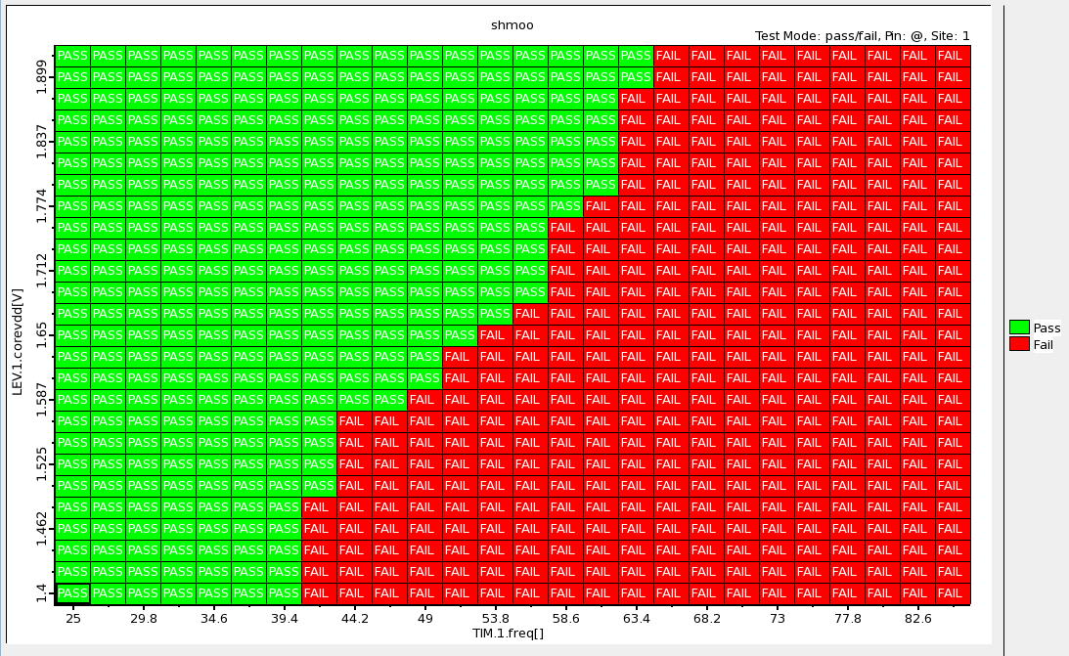
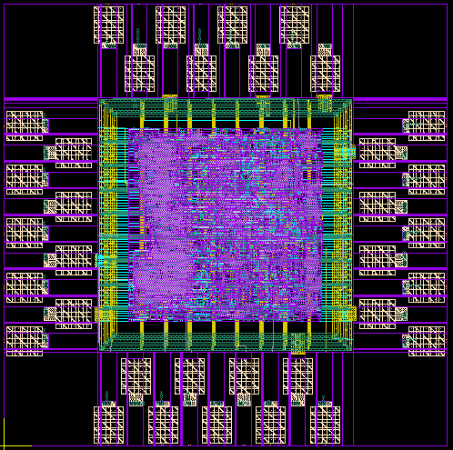
Tape-Out Experience (TSRI教育性晶片)
T18-109B-E0060a (2020.04)
Topic: The Implementation of a Symmetric Encryption Algorithm Based on DES
Process: TSMC 0.18um
Testing reports:
U18-109C-T0045 (2020.08)
Topic: Automatic String Matching Engine (2020 CIC contest project)
Process: UMC 0.18um
Testing results | PASS | Area | 871 um * 868 um
Actual max frequency | 60 MHz | Power Dissipation | 4.334 mW

Slide 18
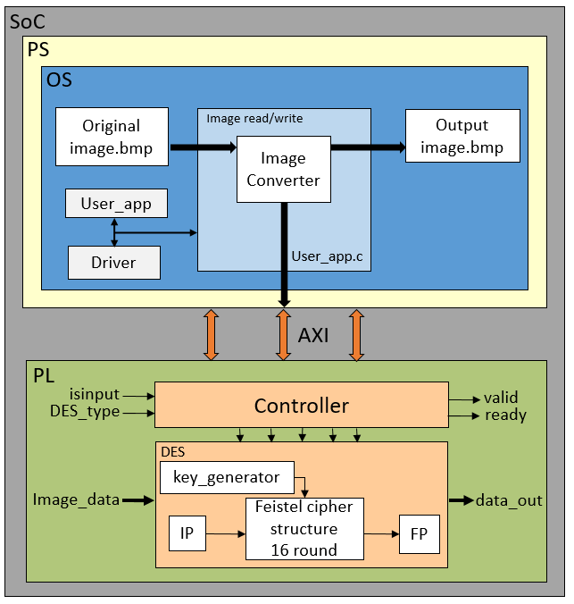
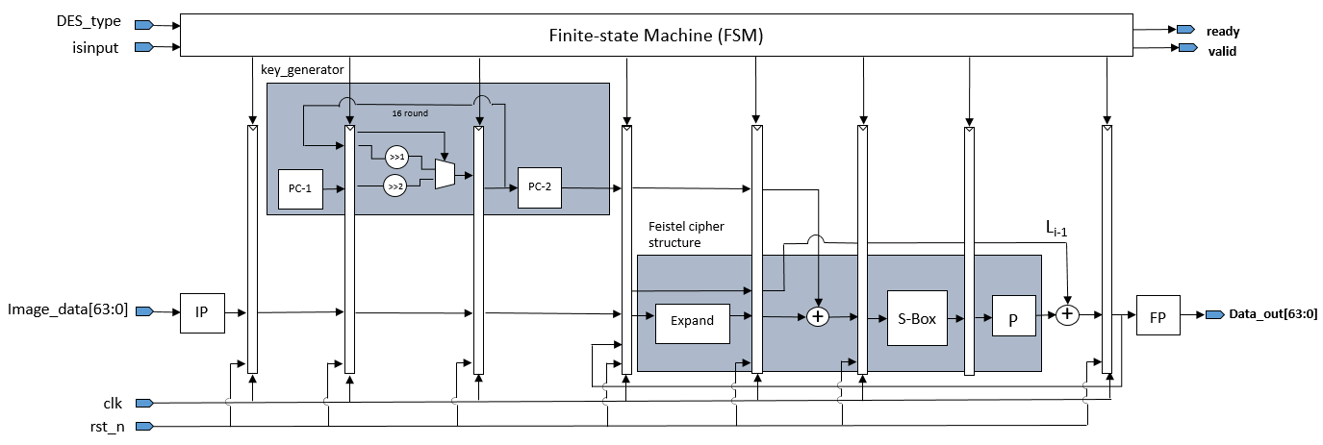
Based On SoC Image Encryption and Decryption System Hardware and Software Co-design (2020.06)
Fig.13 Hardware circuit design based on DES algorithm
Fig.12 Image encryption hardware and software co-design architecture
Notes:
SoC: 將系統整合在單一晶片上，通常有軟體部分及硬體部分。
處理器、記憶體、IO 介面溝通外部、內部會有AXI 溝通特定功能的IPs …..
處理器: ARM Cortex-A9
PS: Processing System
PL: Programmable Logic

Slide 19






Results
採樣圖與其成果 |  |  | 執行時間
原圖 | Encryption | Decryption | Software |  | SoC整合
 |  |  | AMD A9-9420 dual-core RAM 4GB |  | Zynq-7000 (ARM Cortex-A9)
 |  |  | Encryption | Decryption | Encryption | Decryption
 |  |  | 1.870 s | 1.511 s | 0.0527 s | 0.0524 s
 |  |  | 1.746 s | 1.711 s | 0.0526 s | 0.0527 s
 |  |  | 1.887 s | 1.873 s | 0.0529 s | 0.0518 s
Average time |  |  | 1.790 s | 1.556 s | 0.0527 s | 0.0523 s
此專題使用的DES加解密演算法，加密上在SoC系統上比software速度提升了33.97倍，解密上提升了29.75倍，確實達到了目的。
Notes:
圖檔為128*128的BMP

Slide 20
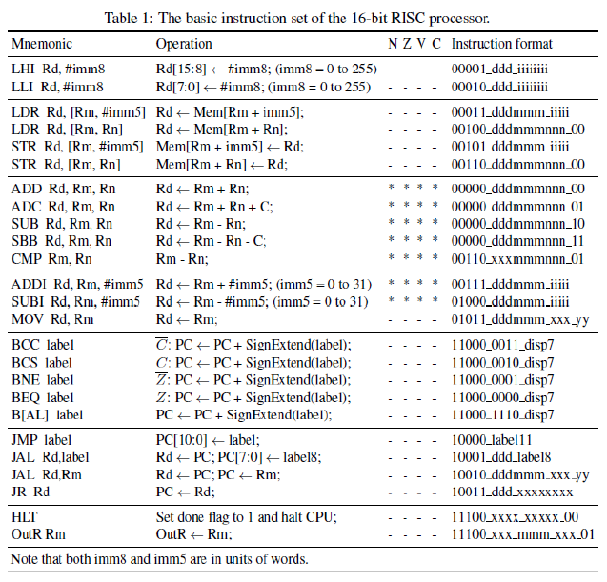
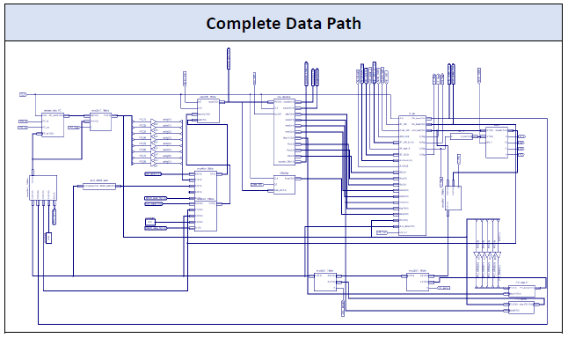
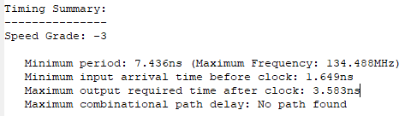
A 16-bits RISC Computer Implement (2019.12)
Post-simulation: PASS
Timing constraints: PASS
Max frequency: 134.488 MHz

Slide 21

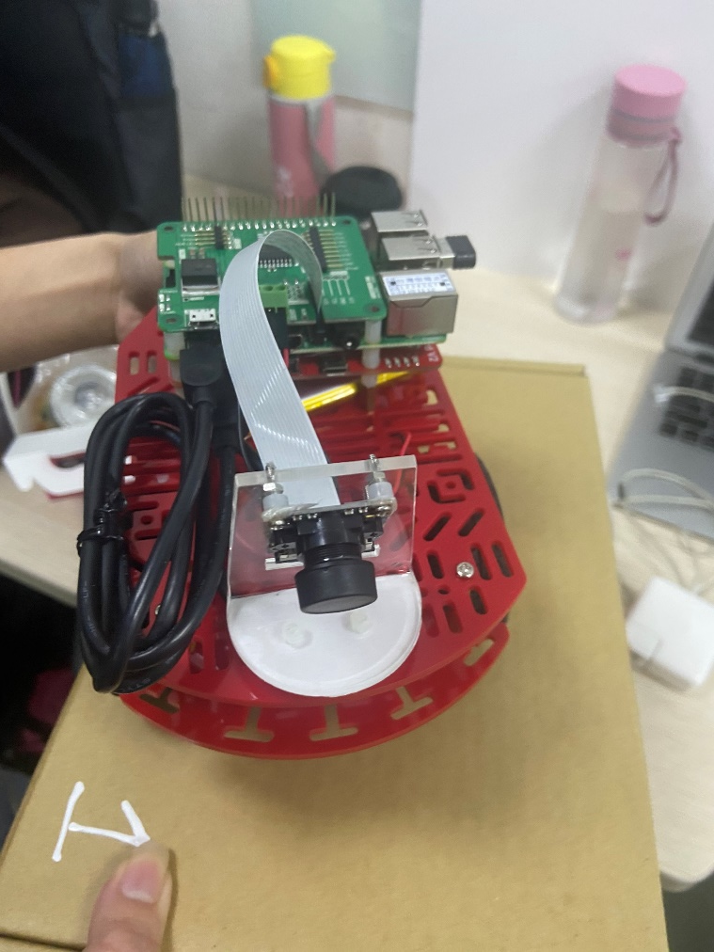
其他相關證書
TSRI 晶片設計實做課程Cell-Based數位晶片設計與實作 (105 hours) (2020.08)
Second Prize of Self-driving System project contest (校內 2020.01)
TSRI Logic Synthesis with Design Compiler (21 hours) (2019.08)
TSRI Cell-Based IC Physical Design and Verification with IC Compiler (21 hours) (2019.08)
ISNST Second Prize of Poster Competition Award (校外-大學專題2018)

Slide 22
Thank you for your attention.

